Slide 1
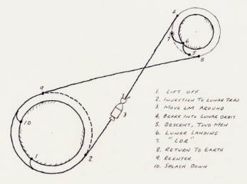



Houston, We Don’t Have a Problem:
Designing Tools to Develop Orbital Mechanics Intuition
Maciek Czyż
Dr. Kaela Martin
Dr. Elif Miskioğlu

Slide 2
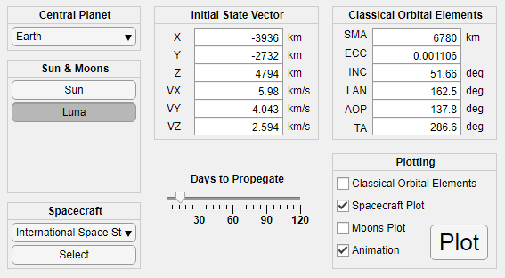
The purpose of this project is to develop a basic orbital mechanics demonstrator with a simple user interface.
Notes:
Verbally talk about developing intuition through experience.

Slide 3
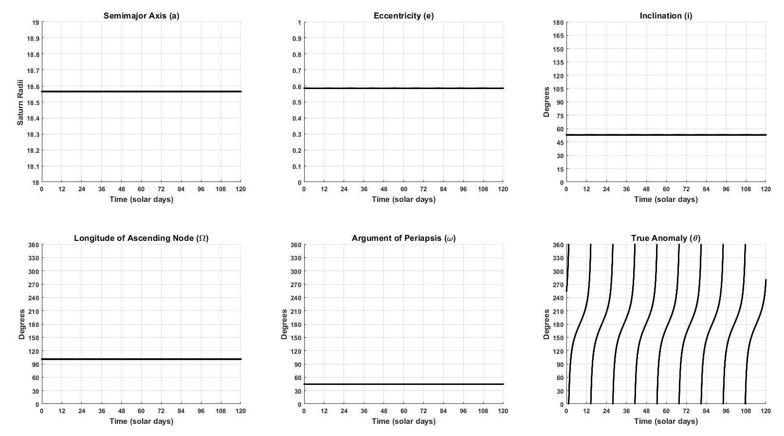
One plot option allows the user to view changes in classical orbital elements during the mission.

Slide 4

The user can compare orbital elements with and without perturbing bodies (i.e. moons).

Slide 5
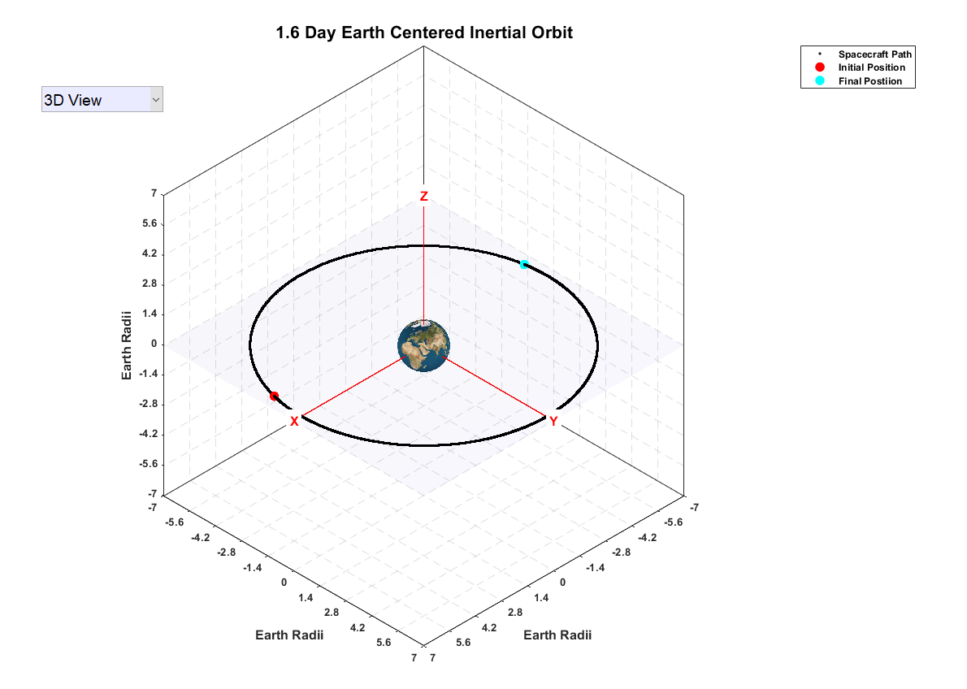
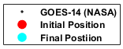
Another plot option shows the spacecraft orbit with a marked initial and final position.

Slide 6
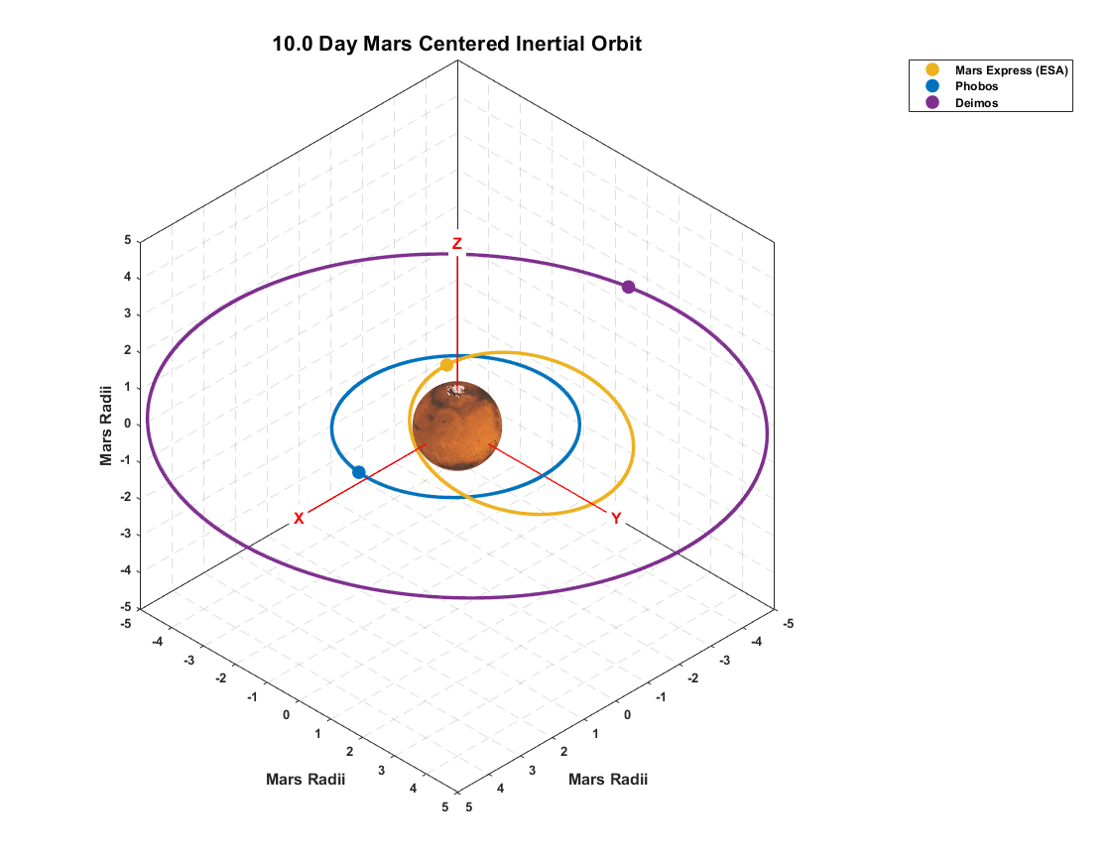
The orbit plot can also include the moons and their final positions.

Slide 7
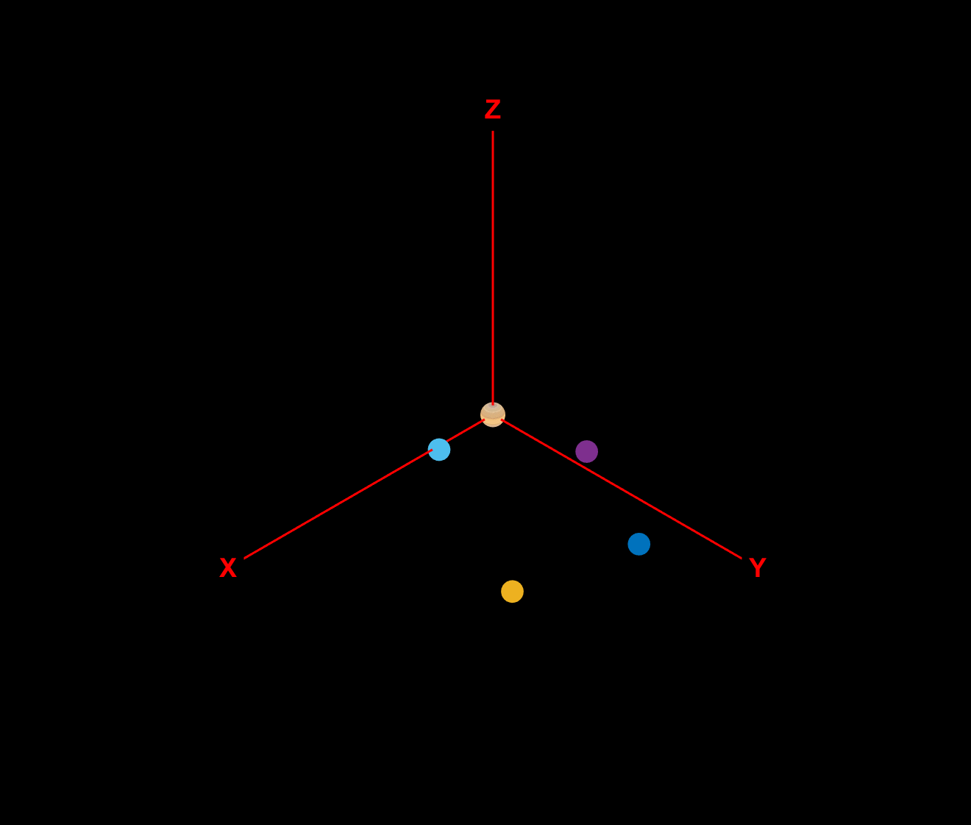
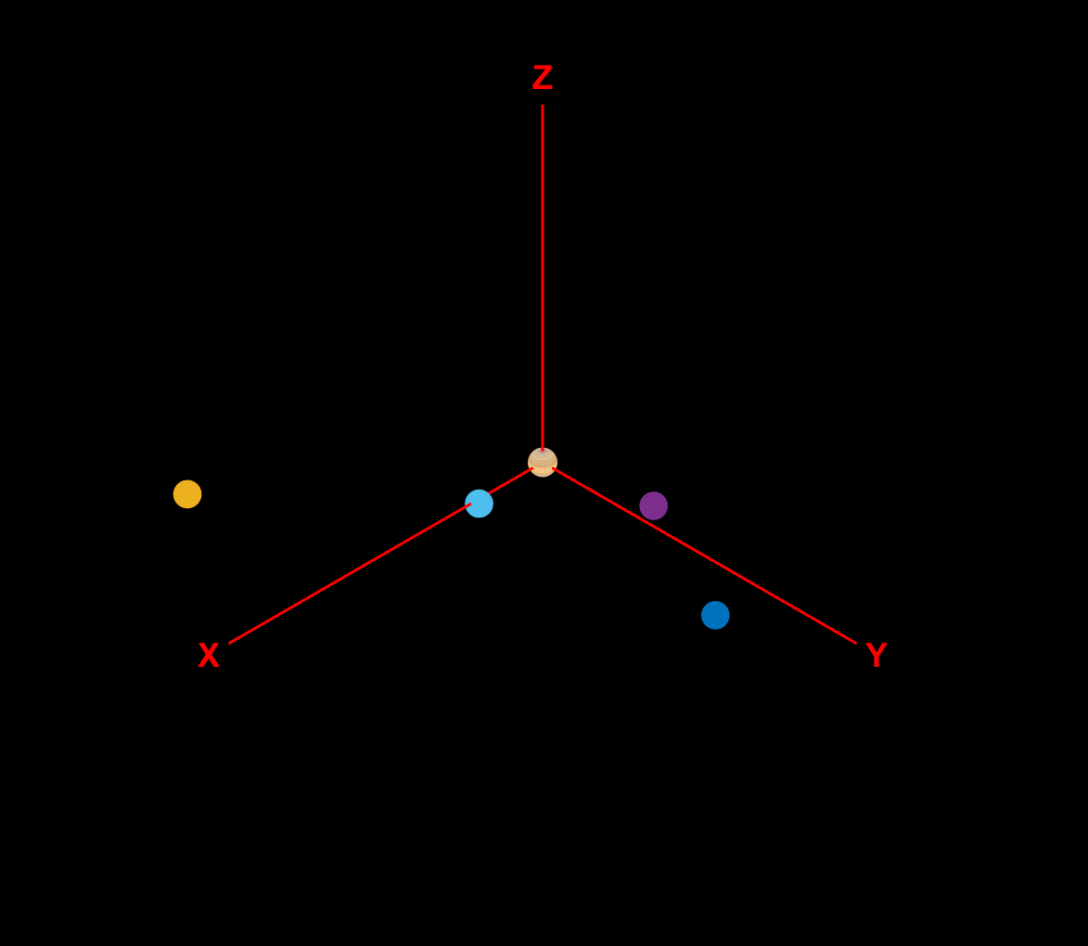
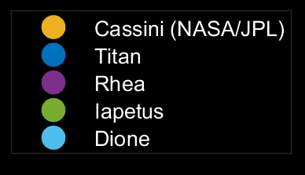
The user can select an animated view of the mission with the spacecraft and moons orbiting the central planet.
Original Orbit
True Anomaly: 159°
Notes:
Students can begin to develop an intuition for mission design by adjusting a spacecraft’s initial conditions and observing the impact on the orbit.

Slide 8
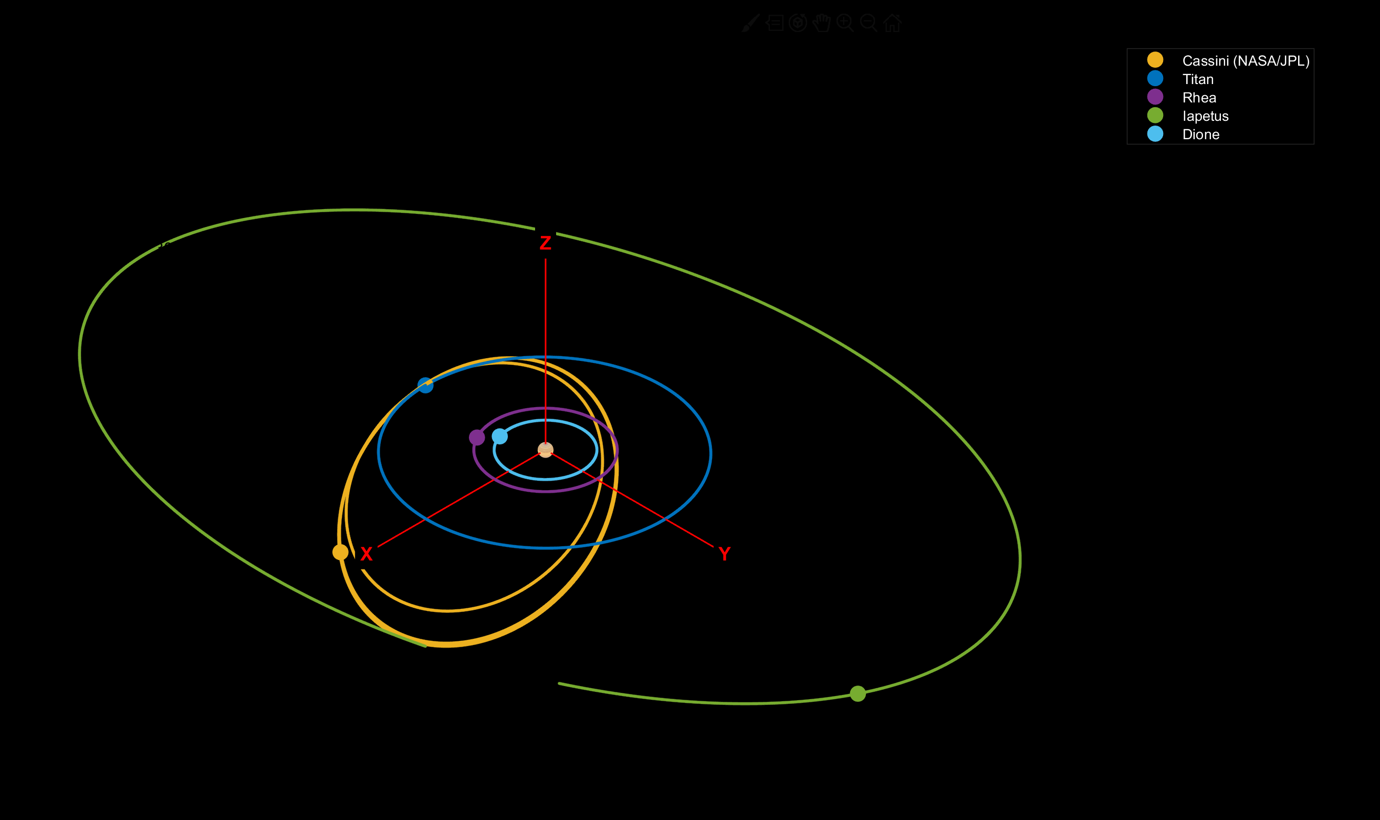
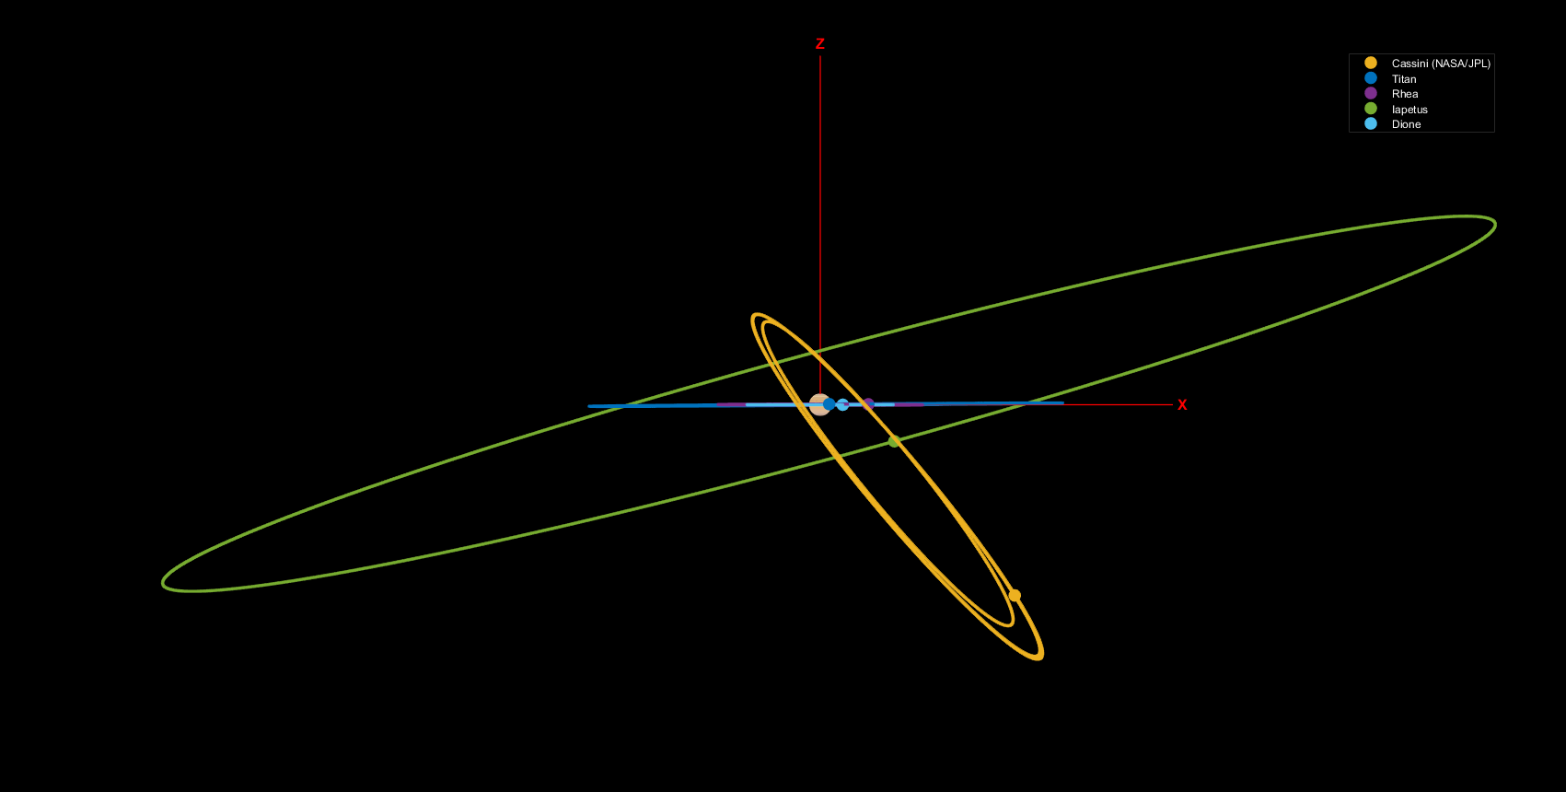
After the animation, a static plot provides the user with more viewing options.

Slide 9
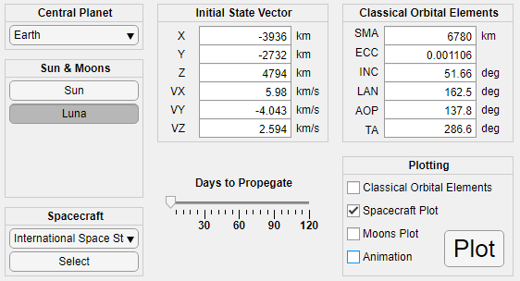
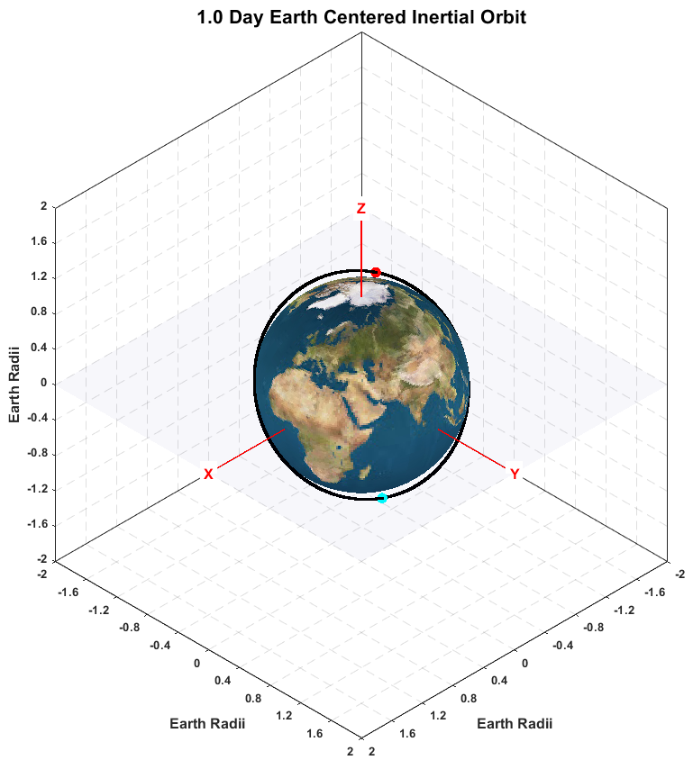
Use of this program could translate to better understanding of orbital mechanics and its corresponding software.

Slide 10




Acknowledgements
Dr. Julio Benavides
Arizona Space Grant Consortium
Embry-Riddle Undergraduate Research Institute

Slide 11
Use of this program could translate to better understanding of orbital mechanics and its corresponding software.
Questions?

Slide 12
References
NASA Jet Propulsion Laboratory “HORIZONS Web-Interface” Available: https://ssd.jpl.nasa.gov/horizons.cgi
D. Garrison “App Designer” Mathworks https://www.mathworks.com/videos/app-designer-117921.html
S. E. Dreyfus and H. L. Dreyfus, "A Five-Stage Model of the Mental Activities Involved in Directed Skill Acquisition," California Univ Berkeley Operations Research Center, 1980.
Background Image: https://pixabay.com/photos/milky-way-starry-sky-night-sky-star-2695569/
Lunar Rendezvous (p1): https://commons.wikimedia.org/wiki/File:Lunar-orbit_rendezvous.jpg

